Slide 1
AGILE PRESENTATION
The Basics of Agile.

Slide 2
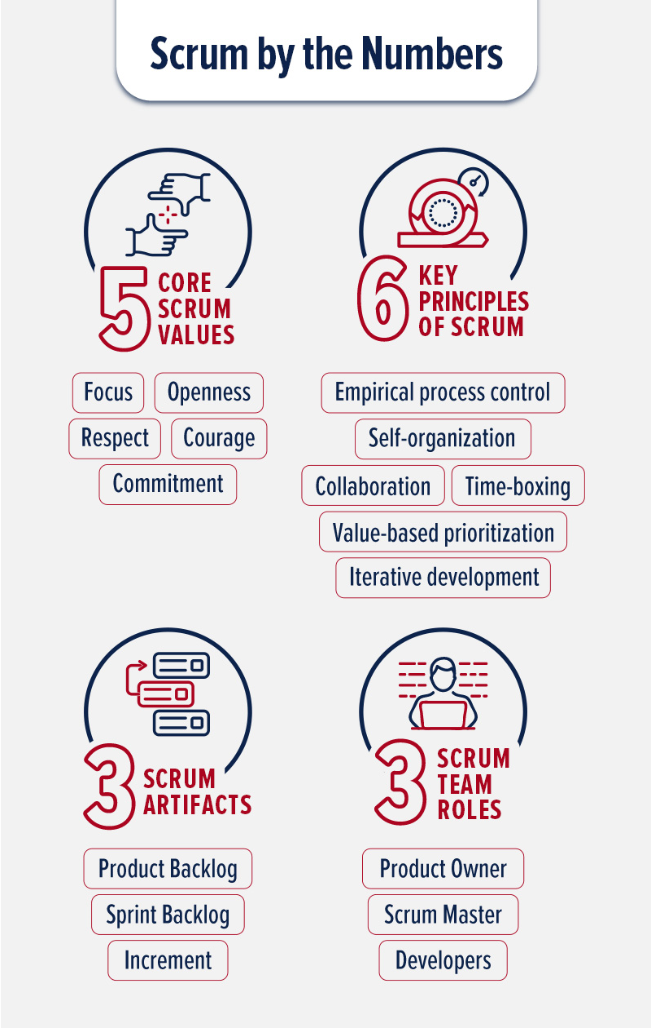
KEY FACETS OF SCRUM-AGILE APPROACH

Slide 3
AGILE ROLES
The agile team consists of the product owner, the scrum master and the development team.
Product owner role.
The product owner is exclusively tasked with managing the product backlog. The work of the development team and the value of the product are maximized by the product owner.
Scrum master role.
The scrum master is a servant-leader for the scrum team. The main responsibility is to make sure that the scrum team adheres to the scrum theory, practices and rules as well as regulating interactions of those outside with the scrum team to those that are meaningful.
Team role.
the development team is where increment happens. It consists of professionals(developers and testers), who are tasked with delivering a releasable increment of ‘Done’ at the end of each sprint.

Slide 4
Agile phases
Ideation- A good software begins with an idea. The product owner works with shareholders, customers and the development team to understand the project requirements. This is important because it helps the product owner to come up with the project scope, vision and also estimate the time, cost and resources required.
Development- Once planning is complete, the development begins. This includes design and coding and is the longest stage in the software development lifecycle. This builds the required functional finished product.
Testing- Before its release to the public, the software must be tested to ensure quality is met, along with all the requirements. Done at the end of each sprint, testing ensures any errors are spotted and rectified before moving on to the next stage.
Deployment- After all assessment and documentation, the software is then deployed to the cloud or server. This in turn ensures that the product is live to the users.
Operations- This stage involves maintenance to keep the software error free. This ensures features are improved for the users’ satisfaction.

Slide 5
The waterfall model
The waterfall model describes a development method that is linear and sequential.
Once a phase is complete, the development moves forward to the next phase and there is no turning back.
It defines and documents detailed requirements and plans for the entire project before the project begins.
If waterfall model had been used instead of the agile methodology, the process would have taken longer to complete and test. For example, an arising issue such as modification of user stories would have been solved differently. This is because when it comes to agile model, the sprint outlining the user stories would have to be modified before the team moved on to development.
However, the waterfall model would have completed the software application before reviewing errors which means having to go back and undo the whole process from where the error is which consumes more time and resources.

Slide 6
Waterfall or agile approach
Customer involvement- the waterfall model restricts customer involvement to the early stages of the project whereas the agile model encourages active customer participation throughout the whole development process. For example, Christy, the product owner, interacted with customers to obtain more details on their preferences for the development of the acceptance criterion.
Risk management- agile model is iterative in nature which allows for early identification and mitigation of risks while the waterfall model identifies issues once testing is done, which is after a substantial amount of work has been completed which involves having to rectify the whole project.
Project phases- agile model operates in short phases called sprints which may overlap while the waterfall model operates in distinct, non-overlapping phases which follow a linear approach. During the SNHU Travel application development, work was broken down into smaller sprints that were easier to complete.

Slide 7
references
DiCesare, M. (2025, January 15). The 5 Stages of the Agile Software Development Lifecycle. Retrieved from Mendix: https://www.mendix.com/blog/agile-software-development-lifecycle-stages/#:~:text=What%20are%20the%20phases%20of,end%20goal%20remains%20the%20same.
DigitalOcean. (2025). Agile vs. Warefall: How to Choose the Right Framework. Retrieved from DigitalOcean: https://www.digitalocean.com/resources/articles/agile-vs-waterfall
Member, U. S. (2025, March 6). What is Scrum. Retrieved from The University of Arizona Global Campus: https://www.uagc.edu/blog/what-is-scrum
Tozzi, C. (2024, May 22). Waterfall vs.Agile Methodology: Differences and Examples. Retrieved from TechTarget: https://www.techtarget.com/searchsoftwarequality/tip/Waterfall-vs-Agile-methodology-Differences-and-examples#:~:text=Waterfall%20is%20a%20stricter%2C%20more,project%20and%20incorporate%20new%20feedback.

